Slide 1
The Best Location for a Manhattan Coffee Stall
Paul Griffin September 2020

Slide 2
Recommending a Coffee Stall location is important for entrepreneurs
New York city already has well over 3000 coffee shops
A high proportion are in Manhattan
Making a location recommendation is important to reduce business risk in a competitive market
A locations suitability is strongly affected by:
Average foot traffic
Competition - The number of coffee shops nearby

Slide 3
Some assumptions
The competitive radius of a location is 100 m
All coffee shop venues within that radius are equally competitive
All Manhattan locations in this study have no laws restricting coffee stalls

Slide 4
Data acquisition and cleaning
This study uses three datasets
Pedestrian Traffic data from NYC Open Data (2017 -2018)
Bi annual count of pedestrians in May and September at AM, PM and Midday.
36 Manhattan locations
Latitude and longitude data reformatted
Continuous, recent data is used from the 2017-2018 time series
1000 separator removed and time series converted to integer
The number of coffee shop venues for each sampling location from Foursquare API.
API call returns a JSON file
Count is contained in the element “totalResults”
List of Manhattan neighbourhoods from (Wikipedia)
Bracketed names, Daggers and Footnotes removed
Duplicate values ignored and unique name assigned manually
Assigned to each row in Pedestrian traffic data

Slide 5

Methodology
This study weighs the importance of two factors at each foot traffic sampling point:
Count of coffee shops in 1 00m radius
The average foot traffic at each sampling point
These datasets are normalised using min-max normalisation:
$$\frac{value−min}{\max{− min}}$$
The following competitiveness score calculated by:
Normalised Foot Traffic – Normalised Count of Coffee Shops
Score is normalised again
The datasets are then plotted on a map
Markers are coloured according to their relative competitiveness

Slide 6
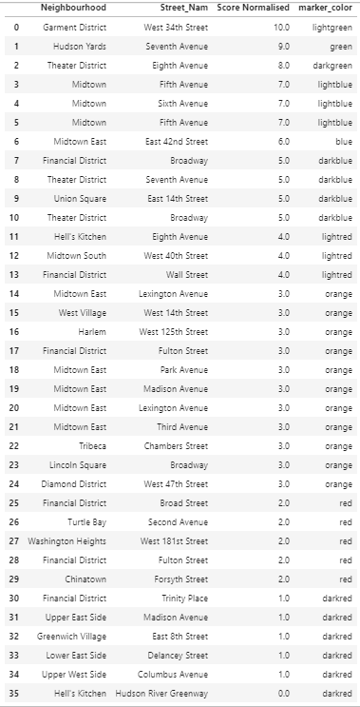
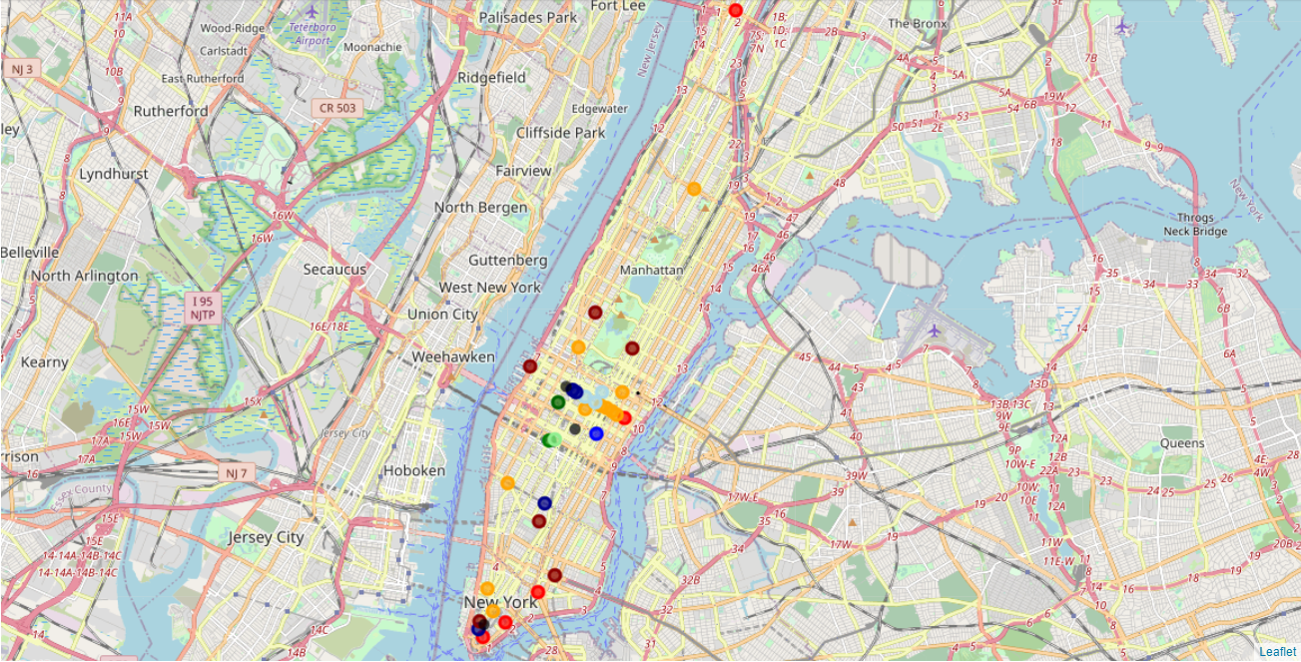
Results

Slide 7
Discussion
Locations that scored over 7.5 are considered the most competitive out of the Manhattan foot traffic sampling locations
West 34th Street in Garment District
Seventh Avenue in Hudson Yards
Eighth Avenue in Theatre District
Foot traffic sampling points appear to be concentrated in Mid and Lower Manhattan with Upper Manhattan underrepresented.

Slide 8
Conclusion and Future Directions
Best locations for a coffee stall are:
West 34th Street in Garment District
Seventh Avenue in Hudson Yards
Eighth Avenue in Theatre District
Conclusions useful in a relative context, but no guarantee of profit or sustainability
Suggestions for further analysis:
Expansion to other areas of New York – Staten Island, Brooklyn, The Bronx
Foot traffic sampling points could be taken at a greater density to provide more potential coffee stall locations.
Dataset for Coffee Shop success (e.g. profitability, lifespan) would allow a predictive model to be created

